Slide 1
MODULE 4

Slide 2
Commutator motors
3phase induction motor-Not a variable speed motor
1 Phase induction motor-Not self starting, poor power factor, efficiency
Common single phase commutator motors are
Series motors
Universal motors
Repulsion motors
Repulsion –induction motors

Slide 3
AC Series motors
If we connect normal dc series motor to ac what happens?
Torque developed is not constant Magnitude
Alternating flux induce eddy currents causing heat and there by loss
No inductive coupling between armature and field since they are placed in quadrature
Sparking in brushes is more due to transformer emf induced
Due to large voltage drop speed reduced
Starting Torque is low, low pf

Slide 4
AC Series motors
Modification needed for ac series motor.
To reduce eddy current loss-Laminations used
To reduce reactance-series field should contains less number of turns
To improve torque no. of armature conductors should be large
To reduce reactance compensating winding should be used
Operating voltage kept low to reduce inductance
Reduce frequency to reduce inductance
Interpoles to reduce armature resistance leads

Slide 5
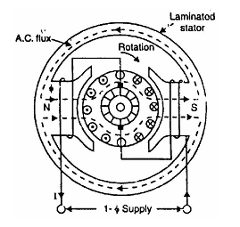
Universal motors
Construction
Changes should be employed to work in both ac and dc

Slide 6
Universal motors
Operation
When motor is connected to an a.c. supply, the same alternating current flows
through the field and armature windings.
The field winding produces an alternating flux fhat reacts with the current flowing in the armature to produce a torque.
Since both armature current and flux reverse simultaneously, the torque always acts in the same direction.
It may be noted that no rotating flux is produced in this type of machines; the principle of operation is the same as that of a d.c. series motor.

Slide 7
Universal motors
Characteristics
The operating characteristics of an a.c. series motor are similar to those of a d.c.
series motor.
(i) The speed increases to a high value with a decrease in load. In very small
series motors, the losses are usually large enough at no load that limit the
speed to a definite value (1500 - 15,000 r.p.m.).
(ii) The motor torque is high for large armature currents, thus giving a high
starting torque.
(iii) At full-load, the power factor is about 90%. However, at starting or when
carrying an overload, the power factor is lower

Slide 8
Universal motors
Applications
The fractional horsepower a.c. series motors have high-speed (and
corresponding small size) and large starting torque. They can, therefore, be used
to drive:
(a) high-speed vacuum cleaners (b) sewing machines
(c) electric shavers (d) drills
(e) machine tools etc.

Slide 9
Single-Phase Repulsion Motor
A repulsion motor is similar to an a.c. series motor except that:
brushes are not connected to supply but are short-circuited - currents are induced in the armature conductors by transformer action.
the field structure has non-salient pole construction.
By adjusting the position of short-circuited brushes on the commutator, the starting torque can be developed in the motor

Slide 10
Single-Phase Repulsion Motor
Construction
The field of stator winding is wound like the main winding of a split-phase
motor and is connected directly to a single-phase source.
The armature or rotor is similar to a d.c. motor armature with drum type winding connected to a commutator
However, the brushes are not connected to supply but are connected to each other or short-circuited.
Short-circuiting the brushes effectively makes the rotor into a type of squirrel cage.
The major difficulty with an ordinary single-phase induction motor is the low starting
torque.
It has also better power factor than the conventional single-phase motor.

Slide 11
Single-Phase Repulsion Motor
Construction

Slide 12
Single-Phase Repulsion Motor
Principle of operation
listen to me…

Slide 13
Single-Phase Repulsion Motor
The total armature torque in a repulsion motor can be shown to be
Ta = sin 2α
where α = angle between brush axis and stator field axis
For maximum torque, 2^{α} = 90° or α = 45°
Thus adjusting α to 45° at starting, maximum torque can be obtained
during the starting period. However, α has to be adjusted to give a suitable
running speed.

Slide 14
Single-Phase Repulsion Motor
Characteristics
(i) The repulsion motor has characteristics very similar to those of an a.c.
series motor i.e., it has a high starting torque and a high speed at no load.
(ii) The speed which the repulsion motor develops for any given load will
depend upon the position of the brushes.
(iii) In comparison with other single-phase motors, the repulsion motor has a
high starring torque and relatively low starting current.

Slide 15
Repulsion-Start Induction-Run Motor
Sometimes the action of a repulsion motor is combined with that of a single phase induction motor to produce repulsion-start induction-run motor (also
called repulsion-start motor).
The machine is started as a repulsion motor with a corresponding high starting torque.
At some predetermined speed, a centrifugal device short-circuits the commutator so that the machine then operates as a single-phase induction motor.

Slide 16
Repulsion-Start Induction-Run Motor
This motor has the same general construction of a repulsion motor.
The only difference is that it is equipped with a centrifugal device fitted on the
armature shaft.
When the motor reaches 75% of its full pinning speed, the centrifugal device forces a short-circuiting ring to come in contact with the inner surface of the commutator.
This short-circuits all the commutator bars.
The rotor then resembles squirrel-cage type and the motor runs as a single-phase induction motor.
At the same time, the centrifugal device raises the brushes from the
commutator which reduces the wear of the brushes and commutator as well as
makes the operation quiet.

Slide 17
Repulsion-Start Induction-Run Motor
Characteristics
(i) The starting torque is 2.5 to 4.5 times the full-load torque and the starting
current is 3.75 times the full-load value.
(ii) Due to their high starting torque, repulsion-motors were used to operate
devices such as refrigerators, pumps, compressors etc.
However, they posed a serious problem of maintenance of brushes, commutator
arid the centrifugal device.

Slide 18
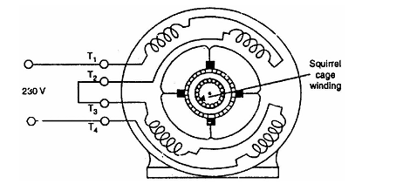
Repulsion-Induction Motor
The repulsion-induction motor produces a high starting torque entirely due to
repulsion motor action. When running, it functions through a combination of
induction-motor and repulsion motor action.

Slide 19
Repulsion-Induction Motor
Construction
It consists of a stator and a rotor (or armature).
(i) The stator carries a single distributed winding fed from single-phase supply.
(ii) The rotor is provided with two independent windings placed one inside the
other.
The inner winding is a squirrel-cage winding with rotor bars
permanently short-circuited. Placed over the squirrel cage winding is a
repulsion commutator armature winding.
The repulsion winding is connected to a commutator on which ride short-circuited brushes. There is no centrifugal device and the repulsion winding functions at all times.

Slide 20
Repulsion-Induction Motor
Operation
(i) When single-phase supply is given to the stator winding, the repulsion
winding (i.e., outer winding) is active. Consequently, the motor starts as a
repulsion motor with a corresponding high starting torque.
(ii) As the motor speed increases, the current shifts from the outer to inner
winding due to the decreasing impedance of the inner winding with
increasing speed. Consequently, at running speed, the squirrel cage
winding carries the greater part of rotor current.
This shifting of repulsion motor action to induction-motor action is thus achieved without any switching arrangement.

Slide 21
Repulsion-Induction Motor
Characteristics
(i) The no-load speed of a repulsion-induction motor is somewhat above the
synchronous speed because of the effect of repulsion winding. However,
the speed at full-load is slightly less than the synchronous speed as in an
induction motor.
(ii) The speed regulation of the motor is about 6%.
(iii) The starting torque is 2.25 to 3 times the full-load torque; the lower value
being for large motors. The starting current is 3 to 4 times the full-load
current.
This type of motor is used for applications requiring a high starting torque with
essentially a constant running speed. The common sizes are 0.25 to 5 H.P.

Slide 22
Single-Phase Synchronous Motors
Very small single-phase motors have been developed which run at true
synchronous speed. They do not require d.c. excitation for the rotor. Because of
these characteristics, they are called unexcited single-phase synchronous motors.
The most commonly used types are:
(i) Reluctance motors (ii) Hysteresis motors
The efficiency and torque-developing ability of these motors is low; The output
of most of the commercial motors is only a few watts

Slide 23
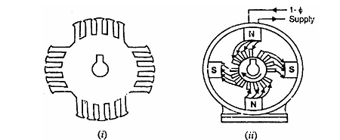
Reluctance Motor
It is a single-phase synchronous motor which does not require d.c. excitation to
the rotor.
Its operation is based upon the following principle:
Whenever a piece of ferromagnetic material is located in a magnetic field; a
force is exerted on the material, tending to align the material so that reluctance
of the magnetic path that passes through the material is minimum.

Slide 24
Reluctance Motor
Construction
(i) a stator carrying a single-phase winding along with an auxiliary winding to
produce a synchronous-revolving magnetic field.
(ii) a squirrel-cage rotor having unsymmetrical magnetic construction.
This is achieved by symmetrically removing some of the teeth from the squirrel cage rotor to produce salient poles on the rotor.
The salient poles created on the rotor must be equal to the poles on the stator.
Note that rotor salient poles offer low reluctance to the stator flux and,
therefore, become strongly magnetized.

Slide 25
Reluctance Motor
Operation
(i) When single-phase stator having an auxiliary winding is energized, a
synchronously-revolving field is produced. The motor starts as a standard
squirrel-cage induction motor and will accelerate to near its synchronous
speed.
(ii) As the rotor approaches synchronous speed, the rotating stator flux will
exert reluctance torque on the rotor poles tending to align the salient-pole
axis with the axis of the rotating field. The rotor assumes a position where
its salient poles lock with the poles of the revolving field
(ii)) Consequently, the motor will continue to run at the speed of
revolving flux i.e., at the synchronous speed.

Slide 26
Reluctance Motor
Operation
(iii) When we apply a mechanical load, the rotor poles fall slightly behind the
stator poles, while continuing to turn at synchronous speed.
As the load on the motor is increased, the mechanical angle between the poles increases progressively.
Nevertheless, magnetic attraction keeps the rotor locked to the rotating flux. If the load is increased beyond the amount under which the reluctance torque can maintain synchronous speed

Slide 27
Reluctance Motor
Characteristics
(i) These motors have poor torque, power factor and efficiency.
(ii) These motors cannot accelerate high-inertia loads to synchronous speed.
The pull-in and pull-out torques of such motors are weak.
Despite the above drawbacks, the reluctance motor is cheaper than any other
type of synchronous motor. They are widely used for constant-speed
applications such as timing devices, signaling devices etc

Slide 28
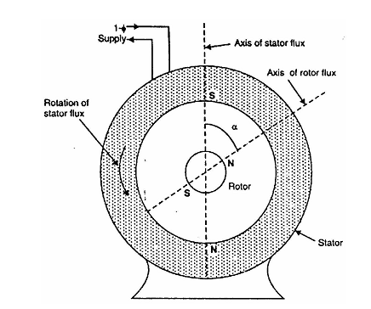
Hysteresis Motor
It is a single-phase motor whose operation depends upon the hysteresis effect
i.e., magnetization produced in a ferromagnetic material lags behind the
magnetizing force.

Slide 29
Hysteresis Motor
Construction
(i) a stator designed to produce a synchronously-revolving field from a
single-phase supply. This is accomplished by using permanent-split
capacitor type construction. Consequently, both the windings (i.e., starting
as well as main winding) remain connected in the circuit during running
operation as well as at starting. The value of capacitance is so adjusted as to
result in a flux revolving at synchronous speed.
(ii) a rotor consisting of a smooth cylinder of magnetically hard steel, without
winding or teeth.

Slide 30
Hysteresis Motor
Operation
(i) When the stator is energized from a single-phase supply, a synchronously revolving field (assumed in anti-clockwise direction) is produced due to
split-phase operation.
(ii) The revolving stator flux magnetizes the rotor. Due to hysteresis effect, the
axis of magnetization of rotor will lag behind the axis of stator field by
hysteresis lag angle ,the rotor and stator poles are locked. If the rotor is stationary, the starting torque produced is given by:

Slide 31
Hysteresis Motor
Operation
From now onwards, the rotor accelerates to synchronous speed with a uniform
torque.
(iii) After reaching synchronism, the motor continues to run at synchronous
speed and adjusts its torque angle so as to develop the torque required by
the load.

Slide 32
Hysteresis Motor
Characteristics
(i) A hysteresis motor can synchronize any load which it can accelerate, no
matter how great the inertia. It is because the torque is uniform from
standstill to synchronous speed.
(ii) Since the rotor has no teeth or salient poles or winding, a hysteresis motor
is inherently quiet and produces smooth rotation of the load.
(iii) The rotor takes on the same number of poles as the stator field. Thus by
changing the number of stator poles through pole-changing connections,
we can get a set of synchronous speeds for the motor.

Slide 33
Hysteresis Motor
Applications
Due to their quiet operation and ability to drive high-inertia toads, hysteresis
motors are particularly well suited for driving
electric clocks
Timing devices
(iii) tape-decks
(iv)from-tables and other precision audio-equipment.

Slide 34
You can download these ppt from
www.tijubaby.weebly.com

